Slide 2
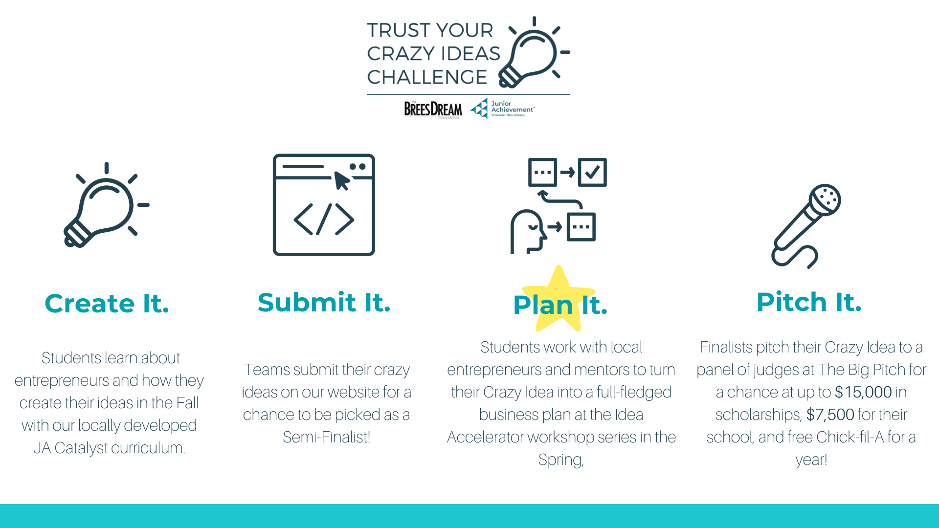

Slide 5
JA IDEA ACCELERATOR
MAKING THE PITCH
FOR MORE INFORMATION PLEASE VISIT WWW.TRUSTYOURCRAZYIDEASCHALLENGE.ORG

Slide 6
JA IDEA ACCELERATOR
UNIT I
FOR MORE INFORMATION PLEASE VISIT WWW.TRUSTYOURCRAZYIDEASCHALLENGE.ORG

Slide 7
How do entrepreneurs get the money they need to start their businesses?

Slide 9
START UP CAPITAL SOURCES
 | Personal Savings | Loans + Credit Cards | Friends, Family, and Fools | Crowd Funding | Accelerator, Incubators, and Pitch Competitions | Angel Investors | Venture Capital
Pros | You own 100% of your company | You own 100% of your company | You own 100% of your company | You own 100% of your company* | Prize money; Making Connections; Mentorship | Usually invests at very early stages; Provides mentorship and advice | Able to invest much more money, typically when a company wants to grow; Provides connections and advice
Cons | You may not have enough money to grow quickly. | Bank loans are very difficult to get. Becomes debt that needs to be paid back with interest. | You run the risk of loosing their money or having to pay them back, depending on your agreement. | Running a successful campaign is time consuming and may fail. | May take a percentage of ownership. | Difficult to get. Smaller Investment; Will take a percentage of ownership | Difficult to get. Take a higher stake; Higher expectations for ROI and expect a greater role in decision making

Slide 10
Investors
Pitch
Competitions

Slide 11
YOU WILL NEED TO CREATE
THE PITCH (SCRIPT) (6 MIN)
A PITCH DECK
A 60 SECOND COMMERCIAL
OPTIONAL PROTOTYPE

Slide 12
What is a pitch?

Slide 13
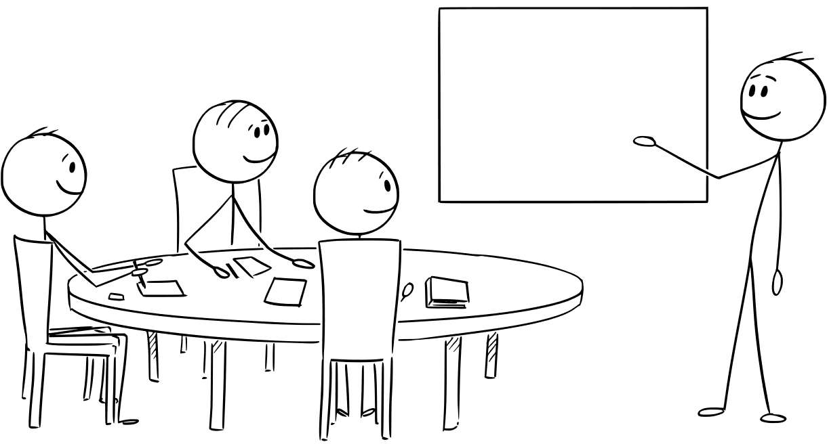
DIAGRAM OF A PITCH
ROBOBUTLER
75% of respondents said that they would use RoboButler.

Slide 15
PUBLIC SPEAKING FOR ENTREPRENEURS
Body Language

Slide 16
PUBLIC SPEAKING FOR ENTREPRENEURS
Body Language: Activity Power Pose

Slide 17
PUBLIC SPEAKING FOR ENTREPRENEURS
Finding Your Voice

Slide 18
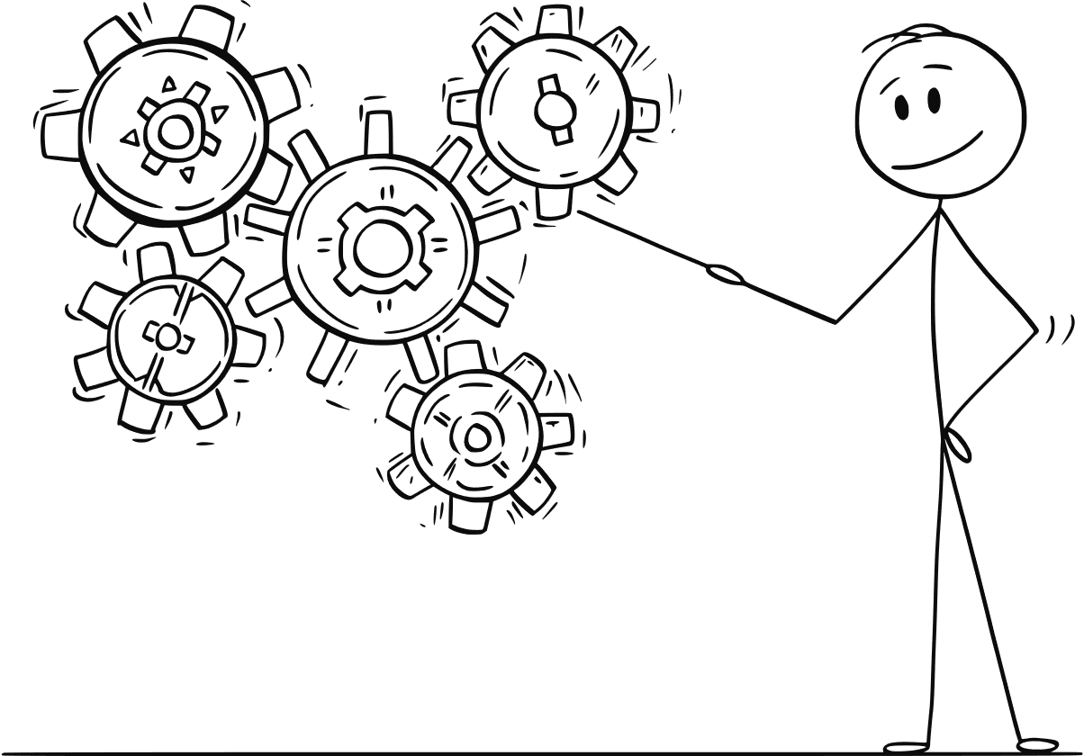
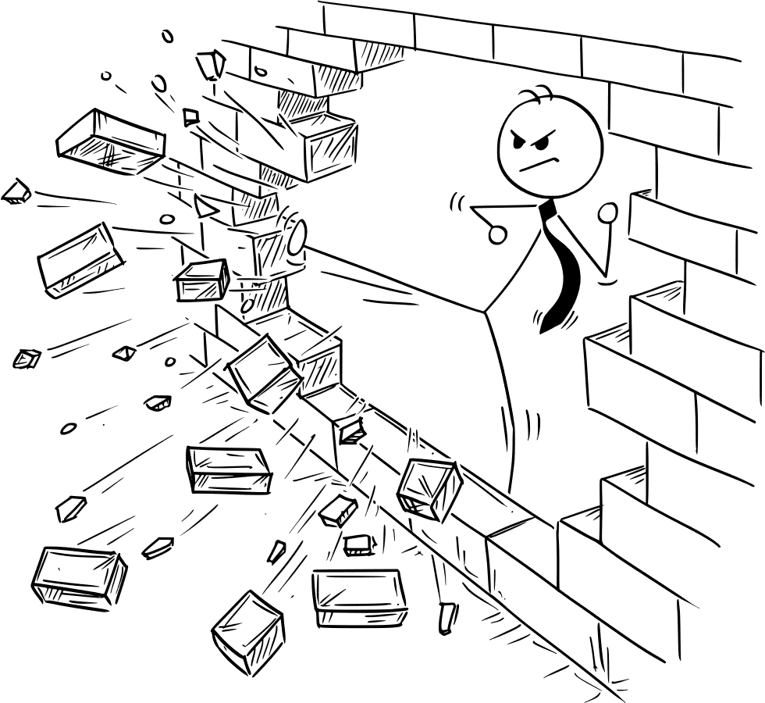
PUBLIC SPEAKING FOR ENTREPRENEURS
Once you know, You know.

Slide 19
JA IDEA ACCELERATOR
SESSION II
FOR MORE INFORMATION PLEASE VISIT WWW.TRUSTYOURCRAZYIDEASCHALLENGE.ORG

Slide 20
WHAT SHOULD YOUR PITCH TELL INVESTORS?:
The problem you are trying to solve is valid and affects many potential customers and the specific PAIN POINTS you are addressing for your customers.
What your solution/product is, how it works, & a demonstration of your product
Your Market Size: Who your customers are, how many people?
Your Business Model + "Go To Market" strategy (you'll learn about this in these sessions)
You understand your competition and can explain your own competitive advantage
Your start-up costs and The Ask

Slide 21
SLIDE ONE: COVER/TITLE
Keep this simple- make sure your logo is easy to read.
You may want to include a one-liner.

Slide 22
SLIDE TWO: PROBLEM
Establishes the overall problem you are trying to solve
Set the stage for why your solution is important
Identify specific pain points that your customers have.

Slide 23
Activity 1: What's Your Problem?

Slide 24
SLIDE THREE: SOLUTION
Clearly describe your product and its features.
Explain how your product is unique and why it is the best solution to the problem.
Remember to talk about specific pain points your solution addresses for your customers.

Slide 27
Activity 2: MVP
Is this the simplest version of the product?
Does my MVP have my main unique value proposition?
Am I solving my customers' most important pain points?
Is my MVP something that can be created at a relatively low cost?
Your Ultimate Goal
Your Big Idea
Your MVP
Unique Value
Proposition

Slide 28
JA IDEA ACCELERATOR
SESSION III
FOR MORE INFORMATION PLEASE VISIT WWW.TRUSTYOURCRAZYIDEASCHALLENGE.ORG

Slide 29
SLIDE THREE: MARKET
Who are your customers
How big is the current market? Is it predicted to grow?
Why is the current solution (if there is one) not working for them.
What is your beachhead market?

Slide 32
HOW CAN I FIND MY BEACH HEAD MARKET?
Small enough to win; Big enough to matter.
Who does this problem impact the most? Who has the most serious pain points?
Who is most likely to adopt a new solution?
Who can afford this solution?
K-12 Students
Young Professionals
Retirees
College Students
Design Professionals
College Students
Start with your customer segments

Slide 33
CUSTOMER
PERSONAS
HELPS YOU TO:
Visualize your customer
Understand their pain points
Learn more about your customers' behavior

Slide 34
ZARA'S CUSTOMER PERSONA
INTERESTS | Travelling, cooking, sports, reading books, psychology.
PAIN POINTS | Feels unprepared for tests; has difficulty studying alone; can't study with friends because it's unproductive.
CURRENT SOLUTION | Studies on her own.
WANTS | To find better ways to study
GOAL | To make good grade and feel prepared for tests
SOURCES OF INFO | TikTok, Instagram, Snapchat, Google News
ADDITIONAL. | Emily doesn't like to study with music on and needs to find a place to study outside of her house because she has noisy younger siblings.
NAME
Emily S.
AGE
15
LOCATION
New Orleans, LA
OCCUPATION
Student
MARITAL STATUS
Single
KIDS
NA
INCOME
Medium Income

Slide 35
Activity 1: Find Your Beachhead Market and Build Your Customer Personas

Slide 38
Activity 2: Customer Interviews
Writing Open Questions

Slide 39
JA IDEA ACCELERATOR
UNIT III
FOR MORE INFORMATION PLEASE VISIT WWW.TRUSTYOURCRAZYIDEASCHALLENGE.ORG

Slide 40
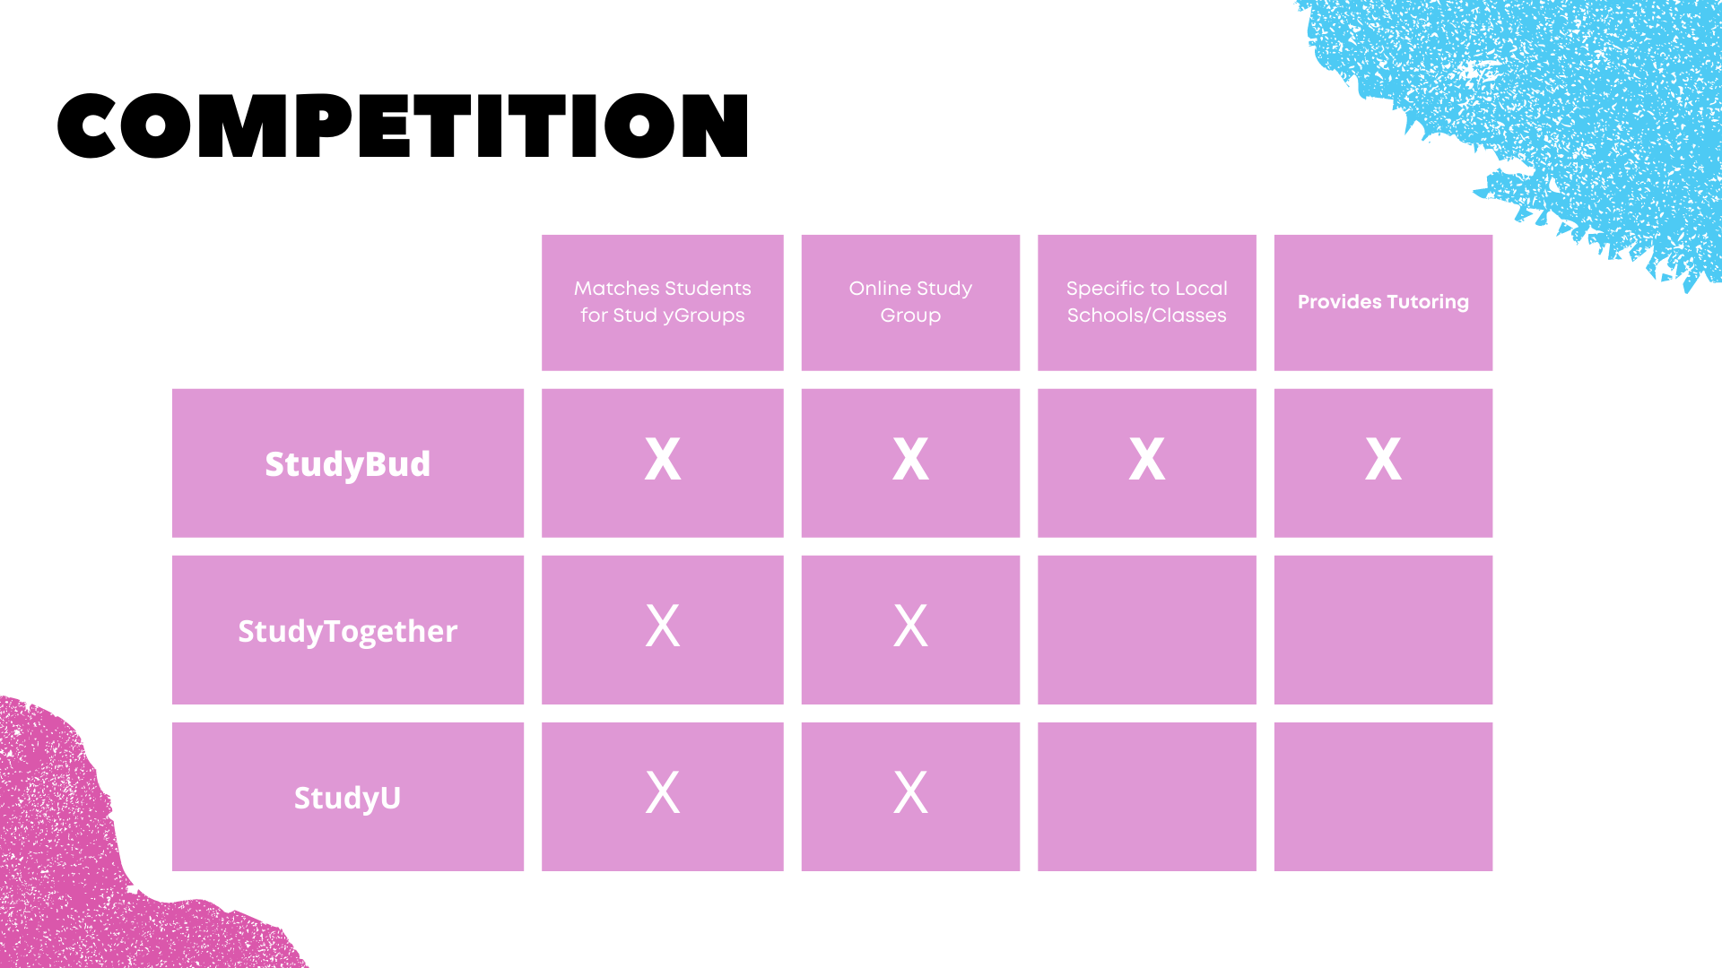
SLIDE FOUR: COMPETITION
Show examples of your competition.
What have you learned from your competitors' business model?
What is your competitive advantage?
Better Features?
Easier to Access?
Cheaper?

Slide 41
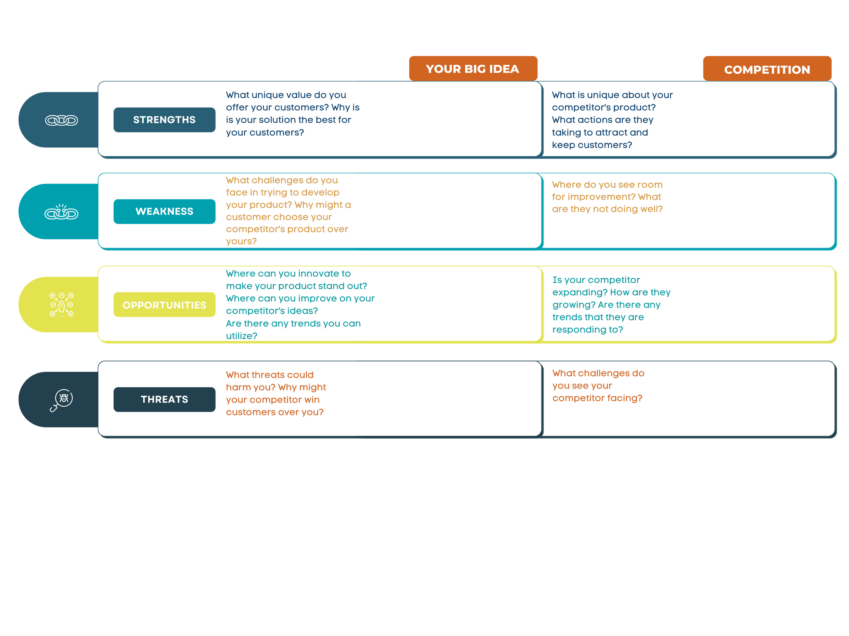
Activity 1: SWOT Competitive Analysis

Slide 42
Business or
Revenue Model
Show the ways your company plans to make money.
How will your business make money?
Direct sales?
Advertising?
Will you offer different levels of service? A subscription model?Or premium versions of your product?
How much will it cost you to get started? How much will it cost for you to achieve market fit?

Slide 44
Go To Market Strategy
BEACHHEAD
MARKETING
CHANNELS
STRATEGY
How do you plan to market your product? Social media? Print? Commercials? How will you reach your customers?
How will customers purchase or access your product. Will you partner with retailers or offer direct sales through a website?
Who is your beachhead market?
How will you expand your market? What's your next steps?

Slide 45
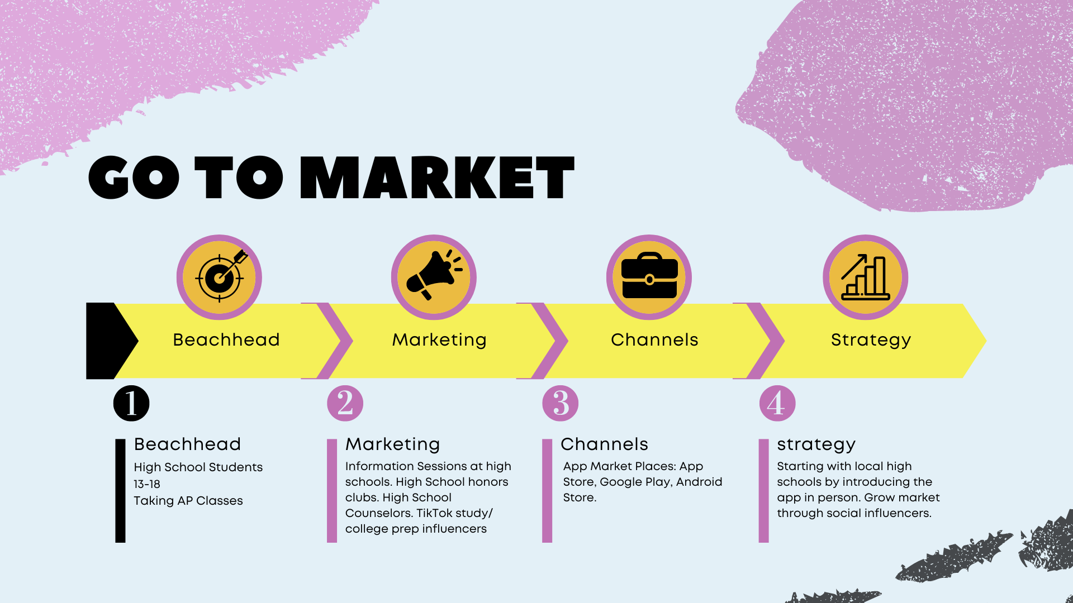
Zara's Go To Market Slide

Slide 46
JA IDEA ACCELERATOR
UNIT IV
FOR MORE INFORMATION PLEASE VISIT WWW.TRUSTYOURCRAZYIDEASCHALLENGE.ORG

Slide 47
COST STRUCTURE
Breakdown of startup costs for your business
Tells investors how you will use their money.
Estimate amounts based on your research. Don't forget to pay yourself!

Slide 48
COST STRUCTURE
Estimate your cost to LAUNCH your company.
This can be to build the ‘alpha’ version of your app
OR
To build your prototype + the first run of your product
Product design, materials, manufacturing costs, shipping and fulfillment, warehousing, etc.
App build, cloud hosting, legal/business opening costs, human resources, maintenance

Slide 49
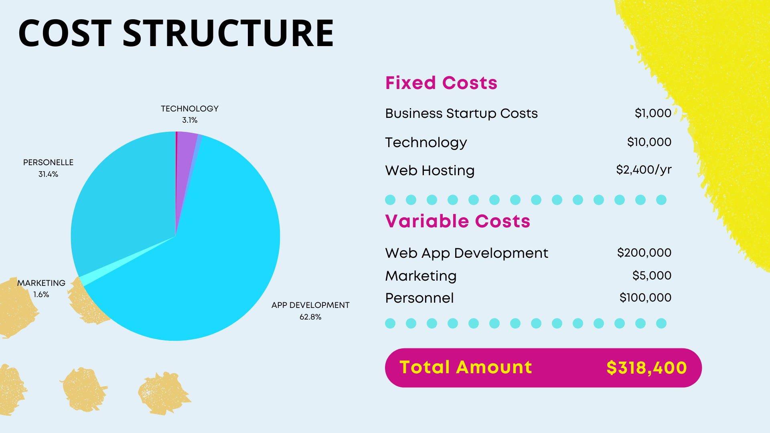

Slide 50
THE ASK
Justify how much money you need by providing a cost structure breakdown
You can also add information about your timeline and major milestones you plan to reach.
Estimate an amount based on your cost to launch. Don't forget personnel in this!

Slide 51
CLOSING
Remind investors why this problem matters.
Highlight key information that you want them to remember.
Give a snappy closing line like “Find Your Buds with Study Bud!”

