Slide 9
determined
Learner
Brave
Persistent
Curious
disciplined
Individual
ethical
Problem Solver
Passionate
impatient
Ambitious
flexible
innovative
Good Listener
enthusiastic
adaptable
driven
risk taker

Slide 12
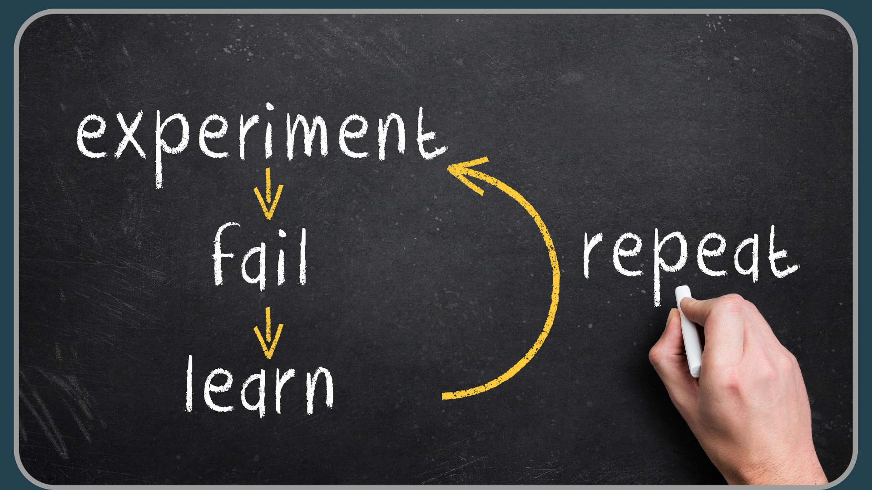

Slide 16
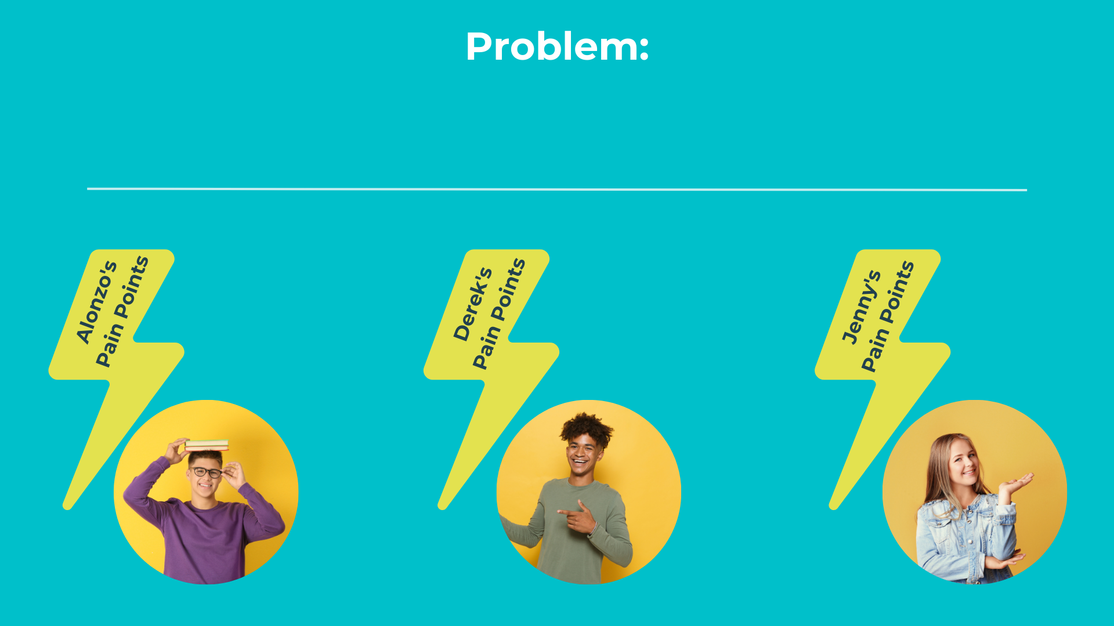

Slide 20
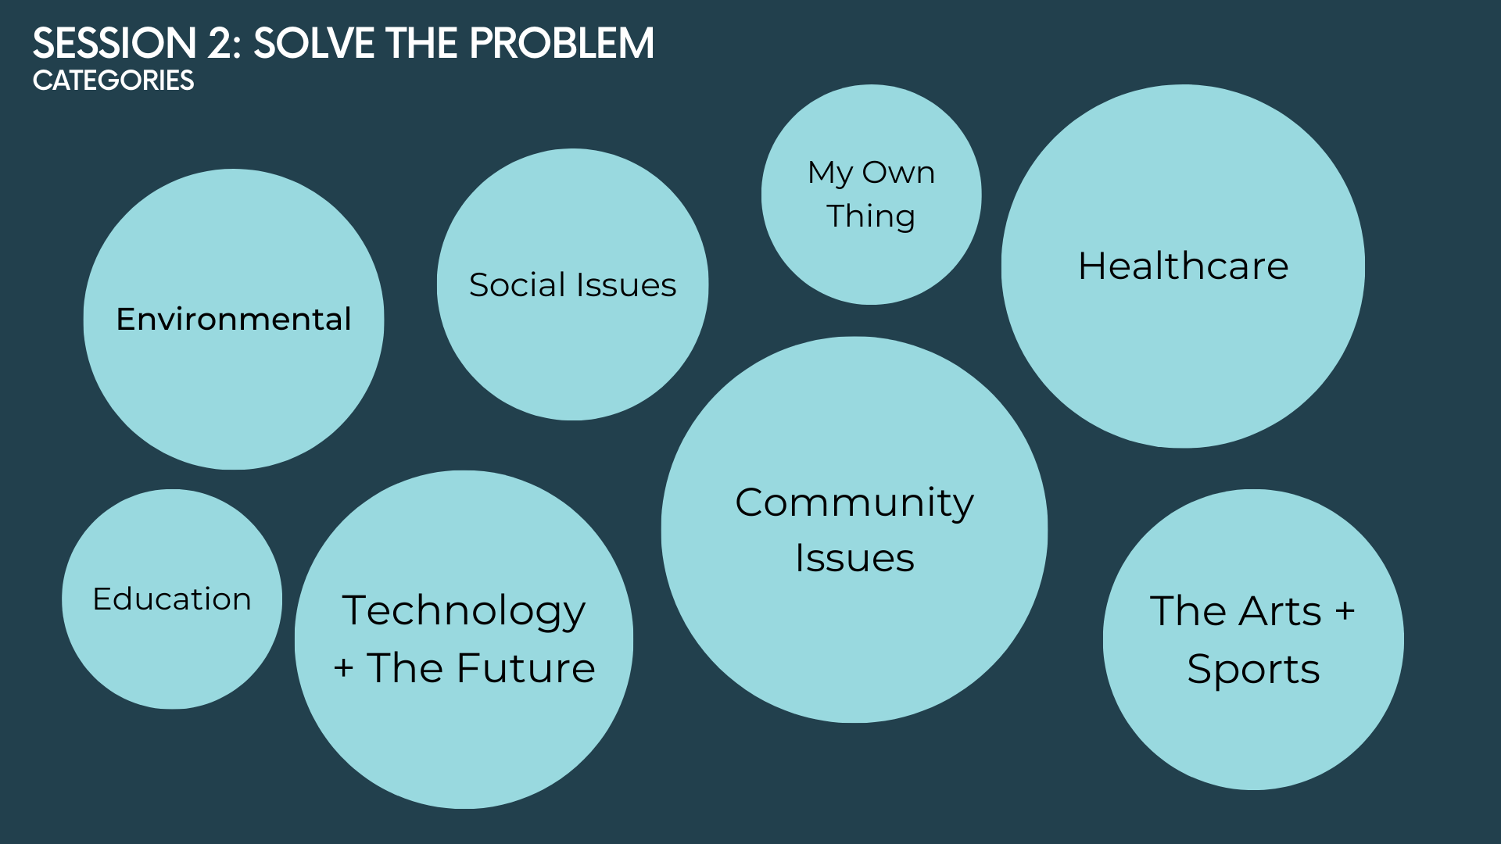

Slide 22
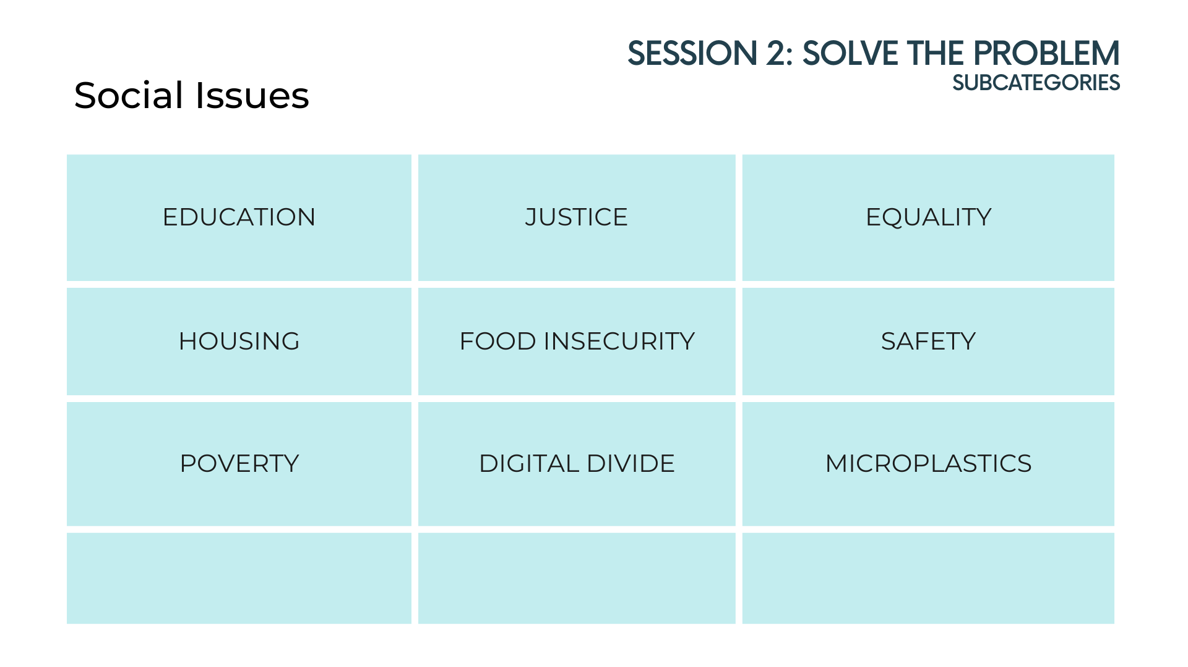

Slide 24
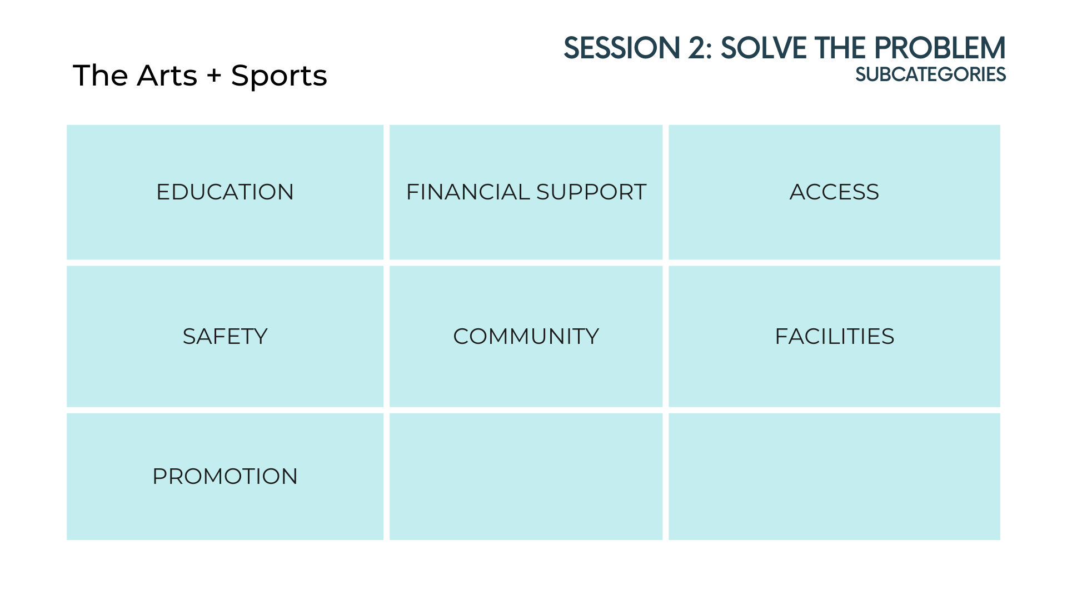

Slide 25
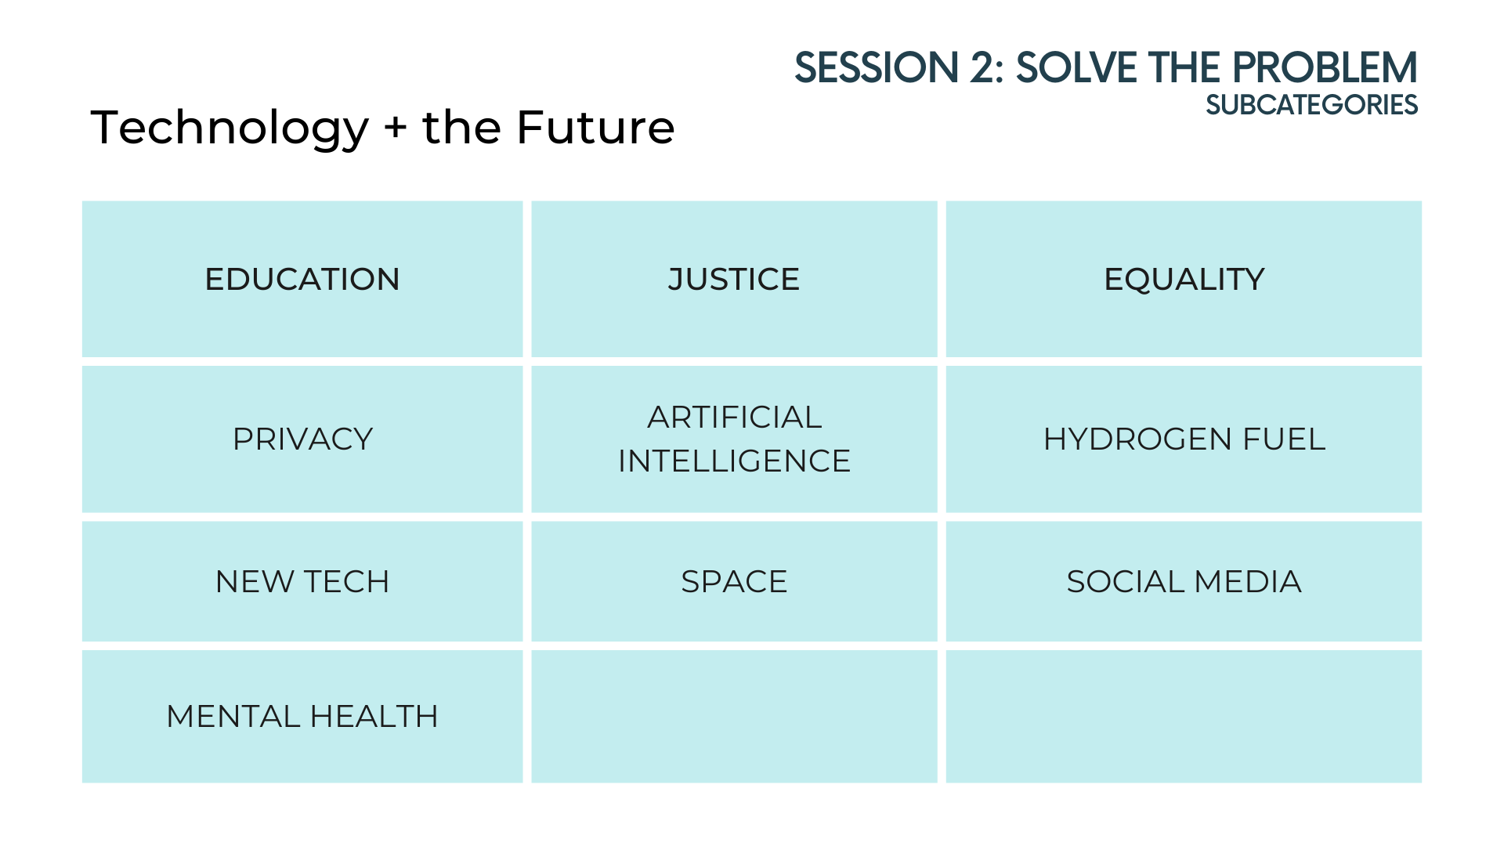

Slide 32
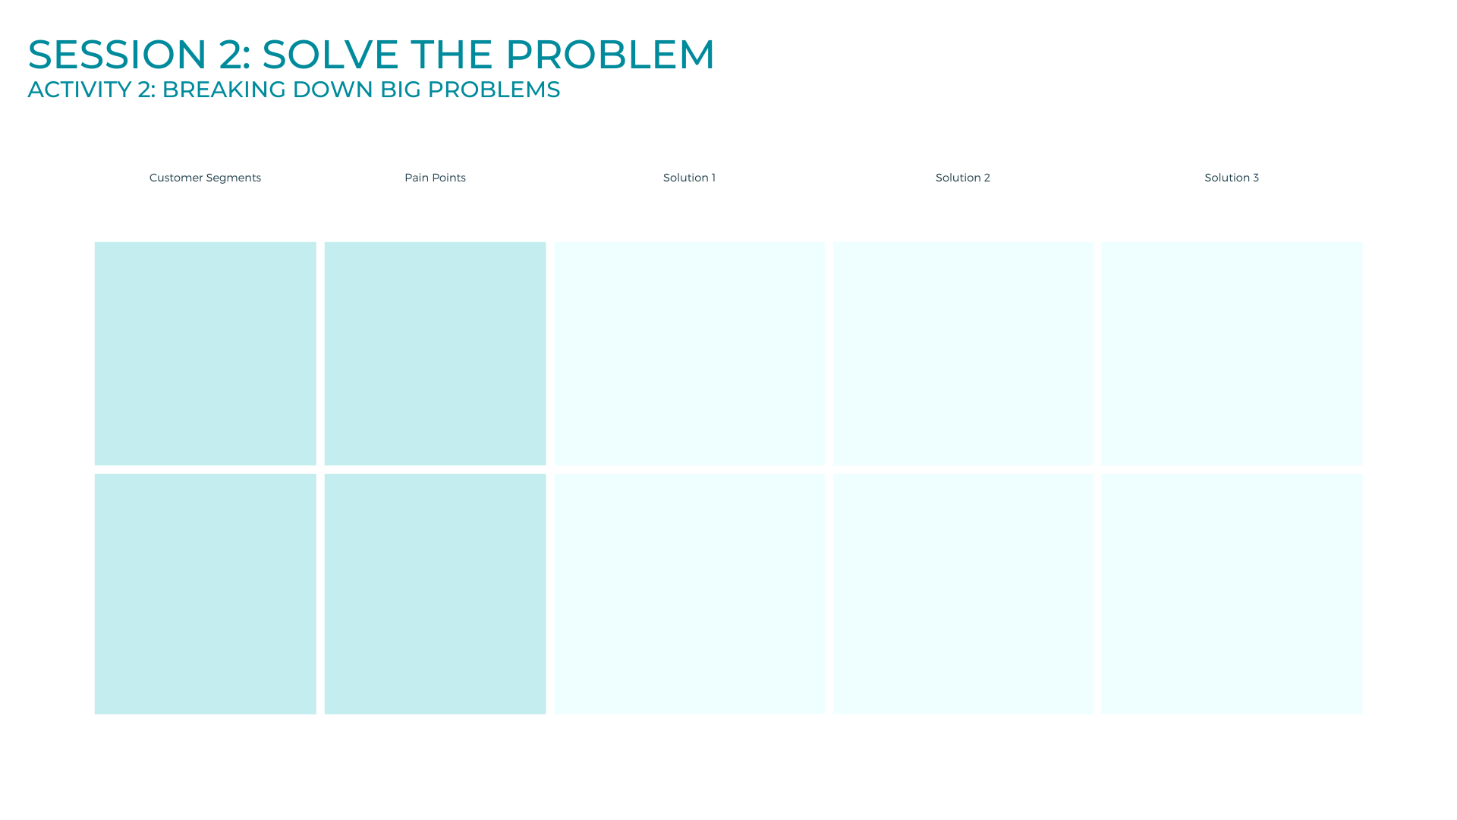

Slide 37
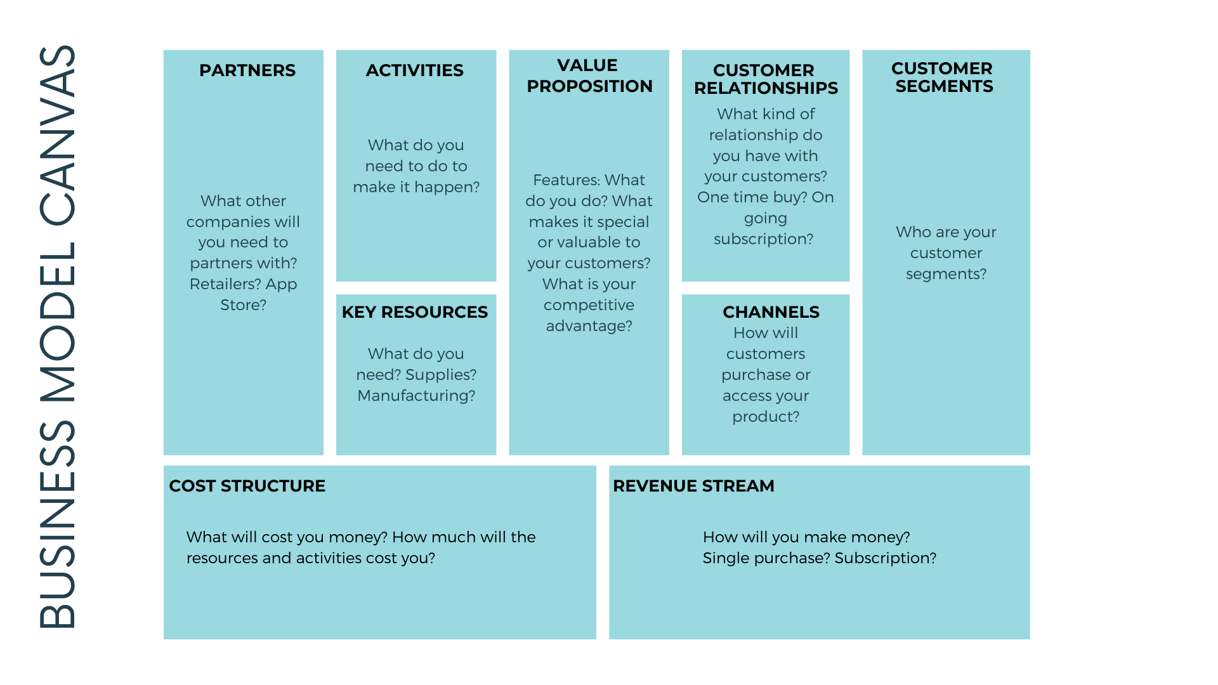

Slide 39
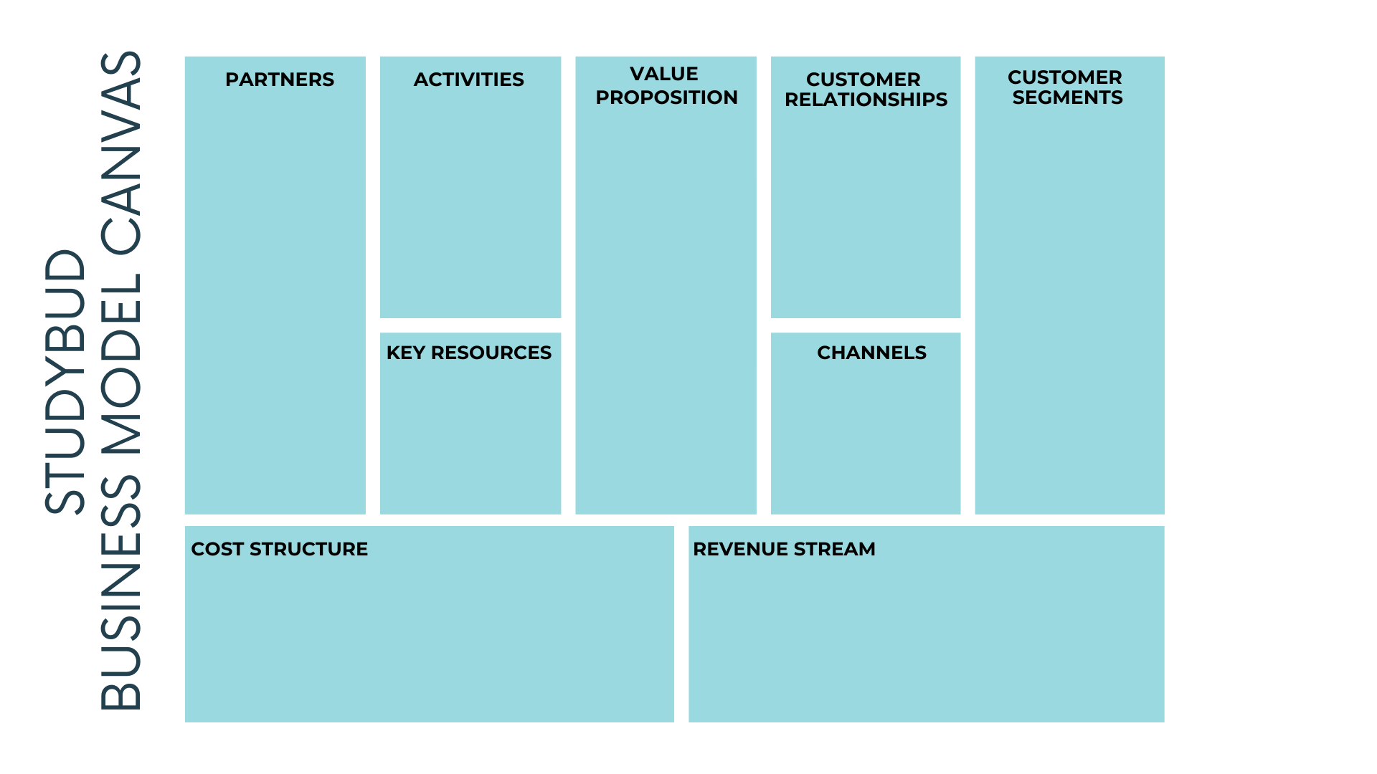

Slide 43
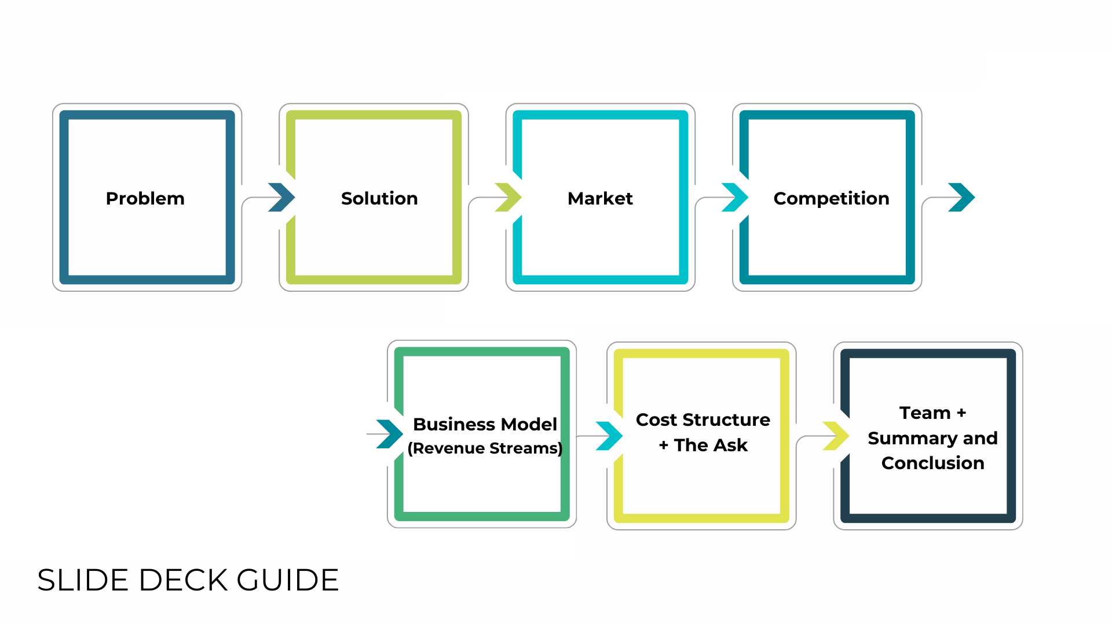

Slide 58
